Slide 1
Edge Overview Series
Product Overview

Slide 2
Agenda
API First
Connected digital experiences
Product line
Edge
API services
Developer services
Analytics services

Slide 3





The Core Design Principle - “API-First”
App Consumption
API Exposure
API adaptations needed for apps
Enable developers for business
Security for app-to-API
App and behavior analytics
APIs architected for abstraction
Enable developers for API use
Security for API-to-backend
API Analytics
Analytics
API
API
App
App Server
Services
Notes:
Description of our place based on Ed/Dilshad’s prez
Core concepts of Edge is API first. Centralized platform that controls access to backend resources. That platform has a couple of “faces” API Exposure layer / façade – talking about SOAP APIs, inconsumable REST APIs. The app consumption façade is what is exposed to developers. The space in between those faces is where you perform transformations, provide for orchestration capabilities, etc.
The API infrastructure service, or “service exposure,” tier - Composed of API service providers (internal backend services and external partner services); services that securely transform existing backend capabilities into APIs; and new data services that power apps (mobile, social, web, and partner) and are aided by self-service API and management portals.
The API developer service, or “API consumption,” tier - Includes services that enable developers to build and deploy apps in a secure way; engage with a developer community; and help manage application life cycles via self-service API and developer portals.

Slide 4






The gap
Connected Digital Experiences
Customers
Employees
Partners
Days
Pace of change
ESB / Integration
CRM, ERP, etc.
SOA
Database
Data Warehouse
Data Lake
Years
Systems of Record

Slide 5
New demands
Connected Digital Experiences
Customers
Employees
Partners
Days
Pace of change
Secure
Scale
Manage
Analyze
Connect
ESB / Integration
CRM, ERP, etc.
SOA
Database
Data Warehouse
Data Lake
Years
Systems of Record

Slide 6
Bridging the gap
Connected Digital Experiences
Customers
Employees
Partners
Days
Edge
Pace of change
Speed of Innovation
Scale
Mission Critical
ESB / Integration
CRM, ERP, etc.
SOA
Database
Data Warehouse
Data Lake
Years
Systems of Record

Slide 7
Intelligent API platform enables the Digital Value Chain
User
Connected Experience
Developer
API
API Team
Backend
Intelligent API Platform
INTELLIGENT API PLATFORM
Notes:
Main Point
The Intelligent API platform enables the digital value chain – enabling you to take a consumption focused approach to designing your APIs and connecting them your back end systems.
Script
We’re enabling these companies to create systems of engagement and realize the digital value chain – connecting their users (customers, partners, and employees) to data flowing from and to their backend systems. In this model, the API, created by your API team, is the key product that developers use to create awesome digital experiences. With the intelligent API platform, you take a consumption focused approach – start with the digital experience you want to deliver. Then work backwards to collaborate with developers to design and develop the right APIs with the right performance and scalability characteristics so they can build digital experiences that always delight customers.

Slide 8


Edge - API Management
Analytics Services
Analytics Services
Business User
Developer Analytics
Ops & Business Metrics
App Performance
Custom Reports
Monitor, manage, and measure success
Developer Services
Developer Services
Developer Portal
Smart Docs
API BaaS
Increase adoption and value of APIs
Monetization
API Team
Developer
API Services
API Services
API Gateway
Policies & Programmability
OAuth &
Security
Versioning & Governance
Build, manage, scale, and secure APIs and Apps
Connected
Experience
Self-Service
State @ Scale
Flexible Deployment
Notes:
Main Points:
Introduce full marketecture
Script:
Apigee Edge enables digital business acceleration with a unified and complete platform, purpose-built for the digital economy. Edge simplifies managing the entire digital value chain with API Services, Developer Services, and Analytics Services.
API Services unites the best of Internet and enterprise technologies with API Gatway, Policies and Programmability, Versioning and Governance, and Oauth & Security.
Developer Services enable a great developer and community experience that accelerates API adoption, simplifies learning, and increases the business value of APIs.
Edge Analytics Services enable end-to-end visibility across the digital value chain with developer analytics, operational and business metrics, App performance, and custom reports that are necessary to monitor, measure, and manage success.
Edge is built on key architectural principles that are key to digital success – maintaining state at Internet scale, self-service throughout the product footprint to improve productivity, and flexible deployment – private or public cloud or hybrid.

Slide 9
API Services
Versioning and Enrichment: Streamlined management and integration
Security: Protection of key systems
Optimization: High performance
Scripting:
Build or reuse custom logic
Protocol Transformation: Enhanced connectivity
Edge API Services
Accelerated Development: Backend-as-a-Service

Slide 10
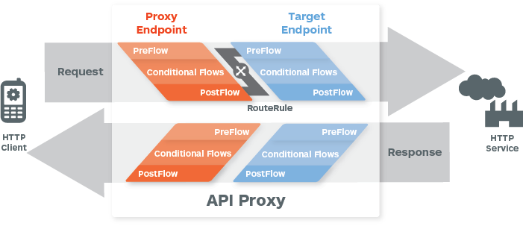
API Services
API Management | Security | API Programmability

Slide 11
Analytics Services
Custom Reports: Personalized views
Data Export: Share or integrate analytics data
Dashboard: Bird’s eye view on traffic
App Analytics:
End to End View
Edge Analytics Services

Slide 12
Analytics Services
Relevant, Actionable and Extensible Dashboards, Tools & Custom Reports
User
App Analytics
Developer Analytics
API Analytics
Backend
App Performance
App Usage
API Performance
Filter by app version, device, platform, OS, etc.
Top Developers
Developer Engagement
Top API Users
Top Products
Top Apps
API Traffic Patterns
API Performance
Geo location
Anomalies
Multiple metrics – traffic, response times, errors, data exchange, etc.
Complete visibility from app end to backend.
Automatically and continuously collect all data about your API traffic out of the box.

Slide 13

Developer Services
Community: Active data sharing and developer engagement
Developer Onboarding: Self-service API adoption
Developer Analytics: provide developer-level visibility
Edge Developer Services
API Modeling: Automated API documentation
Monetize: Deploy business model for API products

Slide 14
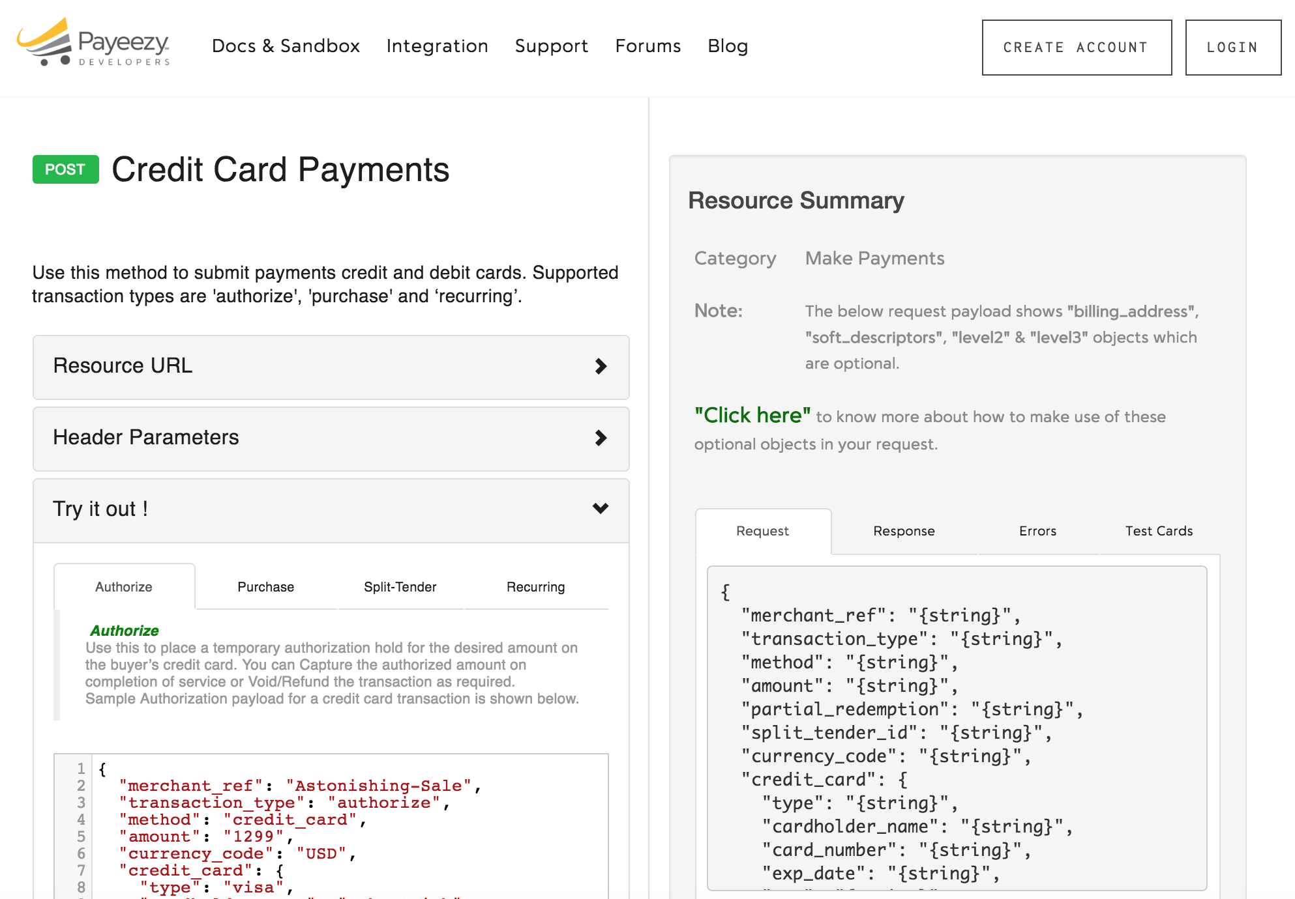
Developer Services – Developer Portal
https://developer.payeezy.com/
Streamline API adoption. Empower developers. Build an interactive community.

Slide 15
Additional reading
Why APIs?
The Definitive Guide to API Management
Two-Speed IT with APIs: Move Fast and Maintain Control

Slide 16
THANK YOU

